Slide 1



Resource Efficiency and Circular Economy Strategies: A Roadmap for Sustainable Growth under G20 and Y20 India

Slide 2


Slide 3
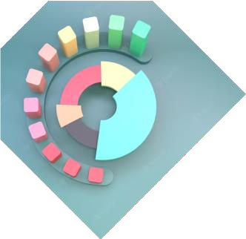

Introduction
The concept of circular economy and resource efficiency explores the economic system of closed loops as a roadmap for sustainable growth. The aim is to maximize resource efﬁciency by reducing waste and promoting reuse, repairing, refurbishing etc. and even leasing. The presentation will provide an overview of the concept of circular economy, and the role of G20 and Y20 in promoting it.

Slide 4

What is a Circular Economy?
“The goods of today are the resources of tomorrow at yesterday's resource prices”
A circular economy is an economic system that is restorative and regenerative by design. It aims to keep products, components, and materials at their highest utility and value. In contrast to the traditional linear economy, which is based on a 'take-make-dispose' model, the circular economy is a closed-loop system that promotes processes such as recycling, reuse, remanufacturing etc.

Slide 5

Benefits of Circular Economy
A circular economy offers several beneﬁts, including reduced waste and pollution, increased resource efﬁciency, lower costs, new business opportunities, and job creation. By adopting circular economy strategies, businesses can become more resilient and competitive, while contributing to the transition to a sustainable economy.

Slide 6
Role of Y20
Y20 or Youth 20, as an official engagement group of the G20, is a platform which caters to the voices of the youth among the G20 members and enables them to express their views, thoughts and concerns on pressing global challenges.
Y20 advocates for policies that promote circular economy and resource efficiency. Engaging academicians, entrepreneurs, legislators, providing policy proposals, and organising policy discussions are all the various ways in which Y20 is driving various critical agendas.
The Y20 can foster collaboration among young people, corporations, and governments in order to develop effective policies and mechanism to strengthen existing work on Circular Economy and Resource Efficiency. This could be done through partnerships, joint projects, and collaborative efforts with other organisations like G20.

Slide 7

Role of Y20
In the preceding Presidency, Y20 Indonesia focused on “Sustainable and Livable Planet in the G20” in the preceding presidency. In the current Presidency, Y20 India identified “Climate Change and Disaster Risk Reduction: Making Sustainability a Way of Life” as one of the key themes and produced a White Paper on it. Y20 India is organizing Talk Series, Chaupals and Consultations on the themes, including Climate Change across the country. Through these discussions, it is attempting to promote dialogue about global problems and shift the focus to probable solutions. It aims to encourage transition to a sustainable living, mitigating disaster risks and accelerating the rise of green energy.

Slide 8
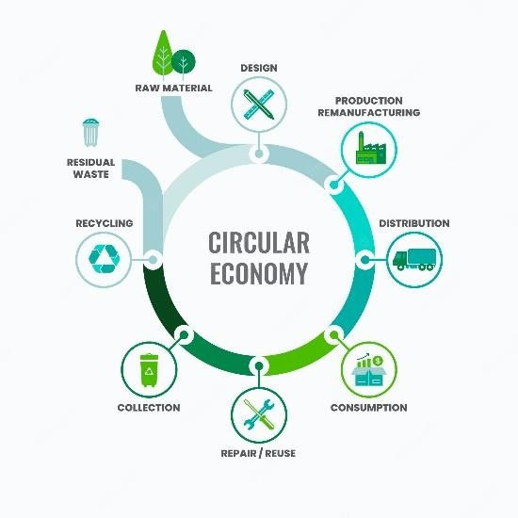
The Contribution of G20 for Bbuilding of a Circular Economy
G20 countries account for 80% of the global GDP and 60% of the global population and are responsible for 75-80% of global greenhouse emissions.
Collective action and commitments of G20 nations can contribute to the idea of a circular economy.
Under India’s G20 Presidency, the Environment and Climate Sustainability Working Group identified priority areas such as Accelerating Ecosystem Restoration Enriching Biodiversity; Promoting a Sustainable and Climate Resilient Blue Economy and Encouraging Resource Efficiency and Circular Economy.
It is holding discussions on the creation of circular economies in various sectors including steel and biowaste and the role of extended producer’s responsibility in the creation of a circular economy. The idea of a G20 industry coalition for resource efficiency and circular economy was also tabled.

Slide 9
The G20 has supported the 2030 Agenda for Sustainable Development, which contains a particular objective on responsible consumption and production (objective 12), which aims to promote sustainable consumption and production practices while decreasing waste and pollution.
The G20 has also launched sector-specific initiatives, such as the G20 Energy Efficiency Action Plan, which aims to improve energy efficiency in key sectors like buildings, transportation, and industry.
There is the G20 Agriculture Working Group, which promotes sustainable and productive agriculture.
By approving the G20 Implementation Framework for Actions on Marine Plastic Litter in 2020, the G20 Environment Ministers pledged to promote the transition to a circular economy.

Slide 10
The G20 formed the G20 Resource Efficiency Dialogue to promote resource efficiency and the circular economy via international collaboration and information exchange.
Under the G20 Finance Track, a Green Finance Study Group was formed in 2016 and a Sustainable Finance Working Group was constituted in 2021 to explore institutional and market hurdles to green finance.
Italy's G20 Presidency is giving to green recovery and climate sustainability, which will be mainstreamed across all tracks, by leveraging Italy's participation in the CoP 26 in collaboration with the UK.
The G20 Infrastructure Working Group promotes investment in infrastructure as a means of supporting economic growth and development and facilitating international cooperation on sustainable infrastructure-related issues.

Slide 11
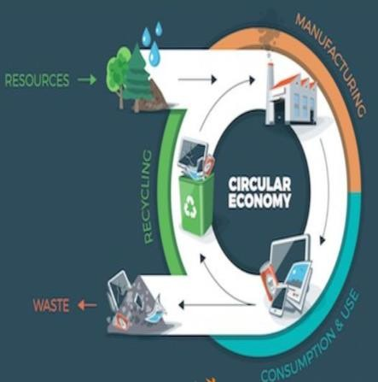
Role of India in Transitioning towards a Circular
Economy
Waste Management: The GoI has launched several initiatives to improve waste management, like the Solid Waste Management Rules, Plastic Waste Management Rules, e-Waste Management Rules, Construction and Demolition Waste Management Rules, Metals Recycling Policy, etc. and the National Clean Energy Fund.
Renewable sources: India has been using so many renewable sources of energy like solar, wind, hydro, and biomass energy. The GoI has even set a target of achieving 450 GW of renewable energy by 2030.
Mobility and Transport: The GoI aims to achieve 30% electric mobility by 2030 and has launched initiatives such as the Faster Adoption and Manufacturing of Hybrid and Electric Vehicles in India (FAME) scheme to promote electric mobility.

Slide 12

Expected Outcome of the Y20 Summit
The Y20 Summit will focus on the concept of promoting sustainable development through innovative and collaborative ways. The focus will be mainly kept on getting the consensus of young leaders, promoting public awareness, and educating the youth of the G20 member nations on critical climate change and disaster risk reduction issues. Resolutions on transitioning to sustainable living; mitigating climate change; shift to and incremental use of green energy may be anticipated.

Slide 13

Expected Outcome of the G20 Summit
The G20 countries may bring together a policy to invest in sustainable infrastructure which would help in the reduction of gross waste generated.
Global promulgation of Mission LiFE: India's call to Sustainable living.
Cooperate with the private sector to promote a circular economy by providing incentives for sustainable practices, and by means of public-private partnerships.
Investments in sustainable lifestyles, leveraging green hydrogen, accelerating progress on SDGs.
Commitments for climate finance.

Slide 14
Ways of Tracking Developments of the G20 and Y20 Summits
Official G20/Y20 website: These sites contain information about the agenda, schedule and outcome of meetings. It also provides live updates and statements from the leaders of participating countries. https://www.g20.org/en/ and https://y20india.in/ .
News channels, Social Media.
Press releases and official statements.
Live streaming: An opportunity to watch the meetings and discussions in real time.

